Slide 1


Slide 2


Slide 3
COMMON PROBLEMS OF GENITOURINARY SYSTEM
Benign prostatic hyperplasia
Uterine prolapse
Urinary incontinence
Urinary retention
Urinary tract infection
Chronic kidney disease

Slide 4
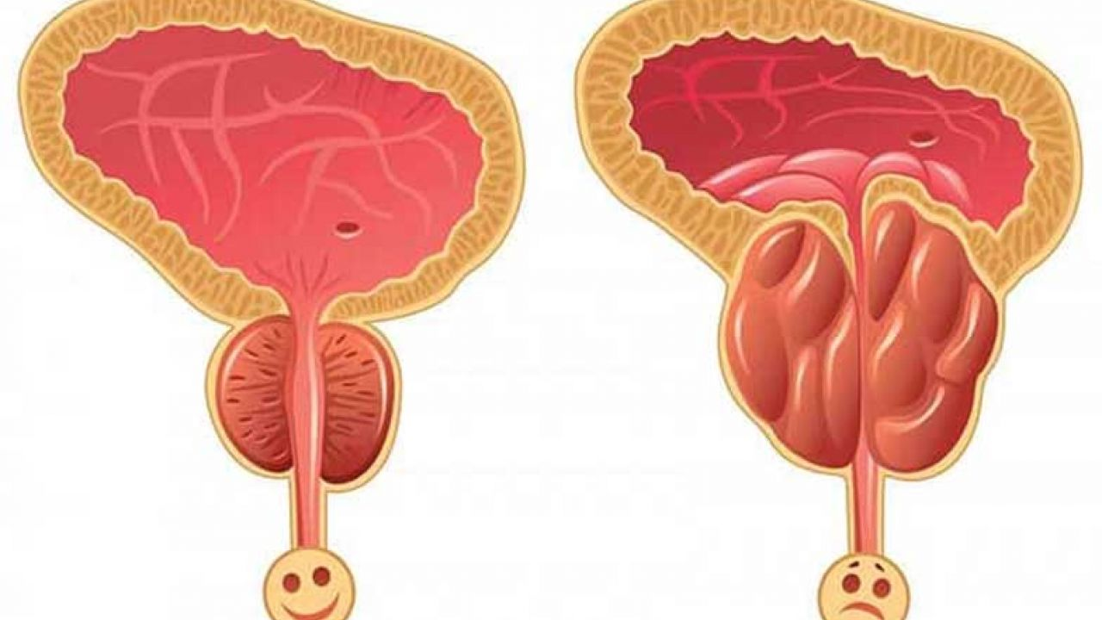

Slide 5
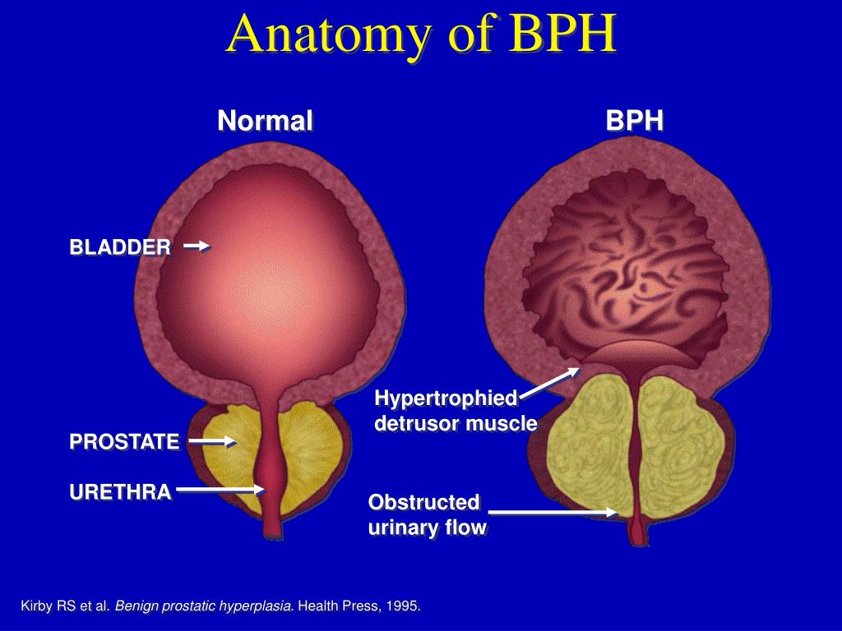
BENIGN PROSTATIC HYPERPLASIA
Prepared by :
Bandana Tiwari
Roll no:6
BNS 2nd year

Slide 6
GENERAL OBJECTIVES
At the end of the classroom session, BNS 1st year students will be able to explain about benign prostatic hyperplasia and uterine prolapse .

Slide 7
SPECIFIC OBJECTIVES
At the end of this teaching session, the BNS 1st year students will be able to :
define benign prostatic hyperplasia
list the causes of benign prostatic hyperplasia
explain the pathophysiology of benign prostatic hyperplasia
state the signs and symptoms of benign prostatic hyperplasia
enlist the diagnostic investigation of benign prostatic hyperplasia
explain the treatment procedure of benign prostatic hyperplasia

Slide 8
Cont..
explain the nursing management benign prostatic hyperplasia
define uterine prolapse
state the degree of uterine prolapse
list the causes of uterine prolapse
state the signs and symptoms of uterine prolapse
enlist the diagnostic investigation of uterine prolapse
explain the treatment procedure of uterine prolapse
explain the nursing management of uterine prolapse

Slide 9

BENIGN PROSTATIC HYPERPLASIA

Slide 10
INTRODUCTION
Benign prostatic hyperplasia (BPH) also known as benign prostatic hypertrophy a benign enlargement of the prostate (BEP), and adenofibromyomatous hyperplasia, is an increase in size of the prostate

Slide 11
Cont…
BPH involves hyperplasia rather than hypertrophy , It involves hyperplasia of prostatic stroma and epithelial cells, resulting in the formation of large, fairly discrete nodules.
Incidence
50 % male have BPH by age of 50 years.
75% men have BPH by age of 80 years.

Slide 12
CAUSES
Unknown
Advancing age
Excessive accumulation of Prostatic androgen (Dihydrotestosterone)
Stimulation by estrogen
Local growth hormone influence

Slide 13
PATHOPHYSIOLOGY
Due to etiological factors
Hyperplasia of the stromal tissue in the prostate
Obstruct the vesicle neck
Incomplete emptying the bladder

Slide 14
Urinary retention
Hydroureter / hydronephrosis
Statis of urine
Leads to urinary tract infection
Azotemia and renal failure may occur

Slide 15
SIGNS AND SYMPTOMS
Frequency of urination
Urgency , nocturia
Overflow and terminal dribbling
Difficulty in micturition with weak stream and dribble

Slide 16
Cont..
5. Pain in suprapubic region.
6. Acute retention of urine.
7. Hematuria

Slide 17
DIAGNOSTIC EVALUATION
History taking
Physical examination
Urine flow rate>15ml/sec is normal
Cystoscopy

Slide 18
Cont..
Trans rectal ultrasonography
Prostate specific antigen (PSA)
Biopsy

Slide 19
TREATMENT
Medical management
Alpha blockers : doxazosin , terazosin
5 alpha reductase inhibitor : finasteride
Analgesic
Proton pump inhibitor

Slide 20
Surgical Management
Transurethral Microwave Heat Treatment(TUMT)
Transurethral Needle ablation (TUNA)
Transurethral Resection of Prostate(TURP)

Slide 21
Cont..
Transurethral Incision of the Prostate(TUIP)
Laser Therapy
Open Prostatectomy

Slide 22
NURSING MANAGEMENT
Assessment
Assess the general condition of the patient.
Perform physical examination.
Assess the patient’s cognitive ability.

Slide 23
Cont..
Monitor vital sign of the patient.
Assess the patient’s knowledge regarding disease condition.

Slide 24
Nursing diagnosis
Acute urinary retention related to bladder obstruction
Strictly monitor intake and output.
Allow patient to open the tap during voiding.
Provide medicine such as alpha blocker helps to urine flow.
Provide catheter as per physician order.

Slide 25
2) knowledge deficit related to disease condition
Establish rapport with the patient and family member
Explain to the client and family member about the disease process with the clear , understandable explanation.
Educate the client and the family about the treatment.
Provide psychological support.

Slide 26
3) Fear and anxiety related to surgical incision
Provide psychological support to the patient.
Communicate patient about their fear.
Provide knowledge regarding his queries.
Provide anxiolytics if needed.

Slide 27
4) Risk for infection related to prolonged catheterization.
Perform catheterization in aseptic technique.
Provide catheter care.
Empty catheter bag frequently.
Change catheter timely.

Slide 28
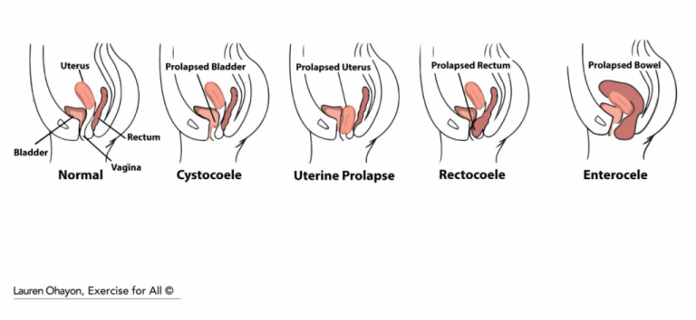

Slide 29
UTERINE PROLAPSE
Uterine prolapse is the herniation of the uterus from its natural anatomical location into the vaginal canal . This is due to the weakening of its surrounding support structures.
It can occur in any age group but commonly occur affect post menopausal women or more vaginal deliveries.

Slide 30
DEGREE OF UTRINE PROLAPSE
First degree:
The cervix drops into the vagina.
Second degree:
The cervix drops to the level just inside the opening of the vagina.

Slide 31
Cont…
Third degree:
The cervix is outside the vagina.
Fourth degree:
The entire uterus is outside the vagina. This condition is also called procidentia. This is caused by weakness in all of the supporting muscles.

Slide 32
CAUSES
Advancing age
Frequent vaginal delivery.
Increased pressure in the abdomen

Slide 33
Cont..
d) Gynaecological surgery
e) Obesity
f) Marfan syndrome

Slide 34
SIGN AND SYMPTOMS
Low back pain.
Feeling that something is coming out of your vagina.
Uterine tissue that bulges out of your vagina.

Slide 35
Cont..
Painful sexual intercourse.
Difficulty with urination or moving your bowels.
Discomfort walking.

Slide 36
DIAGNOSTIC EVALUATION
History taking
Physical examination
USG (Ultrasonogram)
MRI (Magnetic resonance imaging)

Slide 37
TREATMENT
Pesseries:
Vaginal pessary is a silicone device inserted into the vagina. It helps prop up bulging tissues.
Total abdominal hysterectomy.
Vaginal hysterectomy.

Slide 38
NURSING MANAGEMENT
Assessment
Assess the condition of the patient.
Monitor vital sign of the patient.
Monitor patient knowledge regarding disease condition.

Slide 39
NURSING DIAGNOSIS
Acute pain related to disease condition.
Provide calm and quite environment.
Divert the mind of the patient.
Provide well ventilated room.
Provide analgesic as per order.

Slide 40
2) Impaired tissue integrity related to exposed uterus.
Provide psychological support.
Encourage patient to maintain perineal hygiene.
Clean the perineal area from front to back.
Perform dressing if its lacerated.

Slide 41
3) Low self esteem related to disease condition
Maintain good interpersonal relationship.
Encourage patient to ventilate his or her feelings.
Listen attentively to the patient.
Provide psychological support

Slide 42
4) Impaired physical mobility related bulge uterus.
Provide bed rest.
Encourage patient for muscle strengthen exercise.
Tie the bulge part with pessary.
Prepared patient for surgery.

Slide 43


Slide 44


Slide 45
POST TEST
Multiple choice (1*1=1)
The cervix is outside the vagina in …
First degree
Second degree
Third degree
Fourth degree

Slide 46
Cont..
2. True or false(2*1=2)
Benign prostatic hyperplasia is caused by stimulation by estrogen.
(True)
In Uterine prolapse patient feel comfortable while walking .
( False)

Slide 47
ASSIGNMENT
What is benign prostate hyperplasia ? Write it’s nursing management.
What do you understand about uterine prolapse . Write it’s nursing management .

Slide 48
PLAN FOR NEXT CLASS
We will discuss about Urinary incontinence and urinary retention.

Slide 49
REFERENCES
K.C, T, & Rai, B, (2019). A Textbook of Geriatric Nursing. (3rd ed). Heritage publisher and distributors.
Subbha.K,H & Subedi, P,S,(2019). A Textbook of Geriatric Nursing. (1st ed). National book centre.
Baral.R, Essential of Geriatric Nursing. Makalu publication.
Pradhan.M,K & Roka, A,T.(2015). Gerontological Nursing for BN/BSN Students. (1st ed) Vidyarthi publication.
Timalsina,R, (2020). Comprehensive Textbook of geriatric Nursing (3rd ed). Samiksha publication.

Slide 50


